Slide 1

Introduction Frontiers in AI and Data Science
Module 6CM521: Frontiers in AI and Data Science
Ioannis Tsioulis (MC)
Slides acknowledgements:
Dr Hong Qing Yu

Slide 2


Instructor Contact & Resources
Ioannis Tsioulis
i.tsioulis@mc-class.gr
github.com/giannis00

Slide 3
Outlook 1
Core textbooks
Module introduction

Slide 4
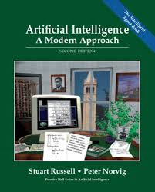
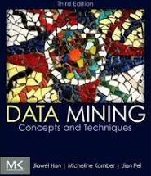
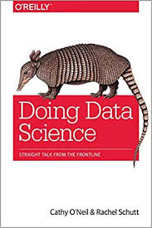

Core textbooks

Slide 5
Module topics (Teaching Weeks)
Weeks | Theory | Practical
1 | AI history, branches, application scenarios and relations to Data Mining and Machine Learning | Python basics
2 | Data Pre-processing and EDA | Python - Data Pre-processing
3 | Mining Frequent Pattern and Association Rules | Python - EDA
4 | Classification and Decision Tree | Python – ARL
5 | Random FR and KNN | Python - DT
7 | Linear Regression & Logistic Regression | Python – KNN
8 | Cluster Analysis with Unsupervised Learning | Python – LR
9 | Artificial Neural Network & Deep Learning | Python – K-Means
10 | Natural Language Processing (NLP) | Python – ANN and DL
11 | Reinforcement Learning & Naïve Bayes | Python – NLP
12 | Knowledge presentation and reasoning | Python – RL and NB
13 | Review
14 -15 | Assessment period
16-18 | Enrichment period: Offsite Activities (Career support, CV support) and assessment feedback
A1 Deadline
Week 14
A2 Deadline

Slide 6
Learning outcomes
MLO1: Explain fundamental concepts in ML/ AI
MLO2: Apply data mining tools to a problem instance and interpret the results
MLO3: Select and justify choice of AI or ML approach for a specific problem instance

Slide 7
Outlook 2
The definition of Data Mining
The definition of AI and relations to Data Mining
A bit of history of AI and branches
Different level of Machine Intelligent (a demo)
Turing test demo for fun
Self-Reading Homework

Slide 8

Data Mining

Slide 9
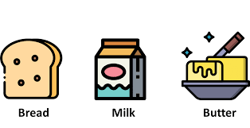


What is Data Mining?
Data mining is a process to turn raw data into useful information and knowledge by using software and algorithms to look for patterns in large batches of data.
For example: businesses can learn more about their customers to develop more effective marketing strategies, increase sales and decrease costs.

Slide 10
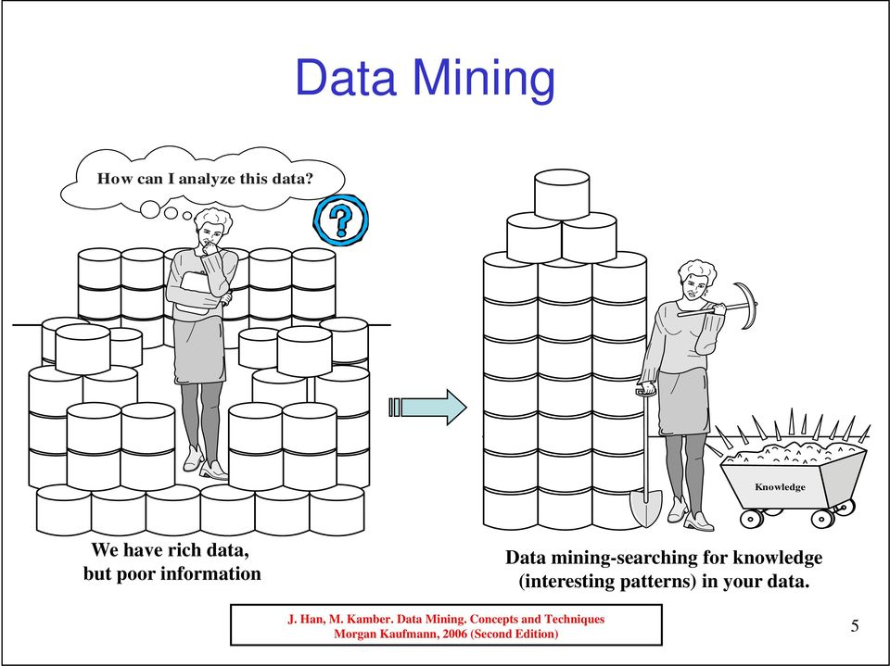
Aim of Data Mining

Slide 11
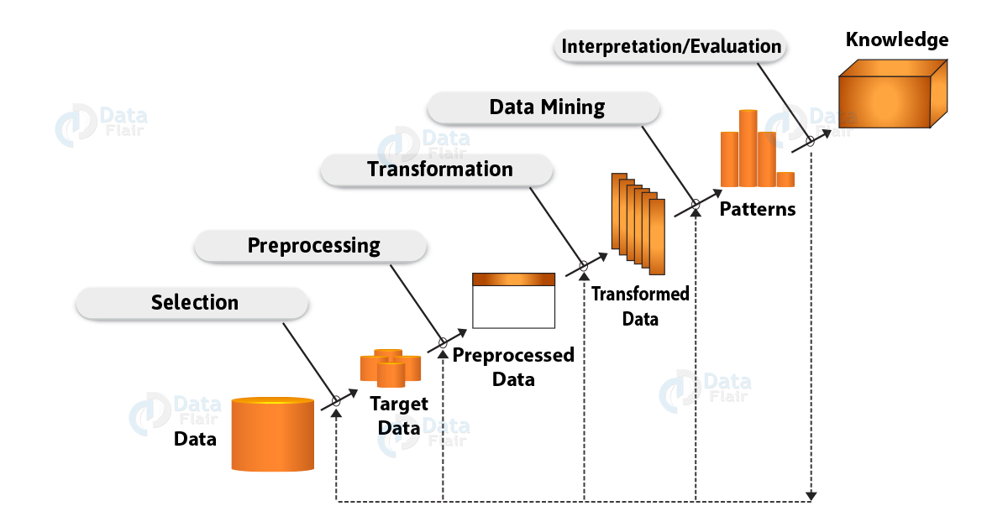
An important step of knowledge discovery

Slide 12
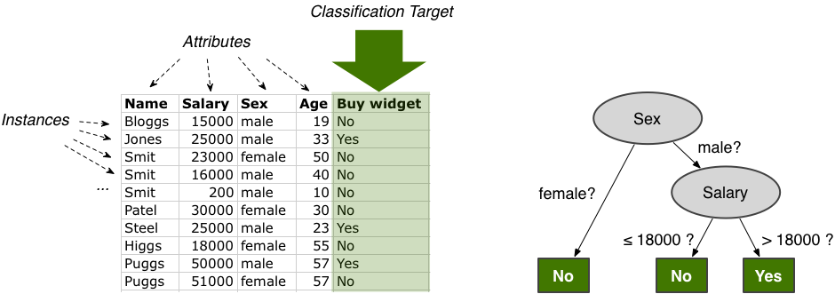
Data Mining example

Slide 13

Artificial Intelligent (AI)

Slide 14
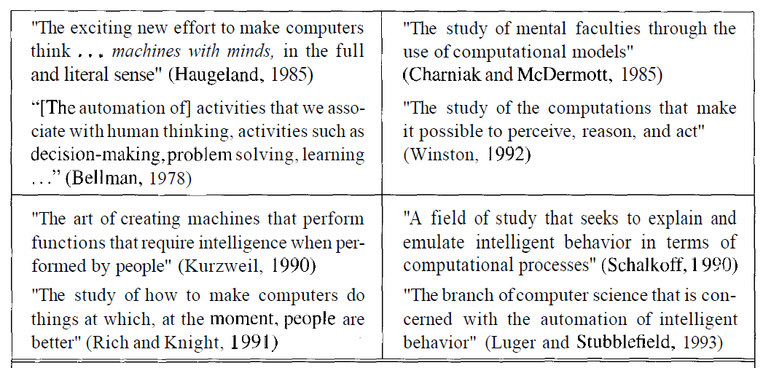
What is AI?
Artificial Intelligence, A Morden Approach. Second Edition
Systems that think like humans | Systems that think rationally
Systems that act like humans | Systems that act rationally

Slide 15
Morden or Your Definition
“AI refers to the simulation of human intelligence in machines that are programmed to think like humans and mimic their actions. The term may also be applied to any machine that exhibits traits associated with a human mind such as learning and problem-solving.”
Investopedia
AI refers to a soft or hard device that can make inferences and best decisions to support next action or provide recommendations through collected digital information and humankind learning process.
- Me

Slide 16

The title of the module
Data Mining and Foundation of AI (Good name) but you may feel a bit confusion.
Actually, data mining partially belongs to AI field
How about MACHINE LEARNING then?

Slide 17
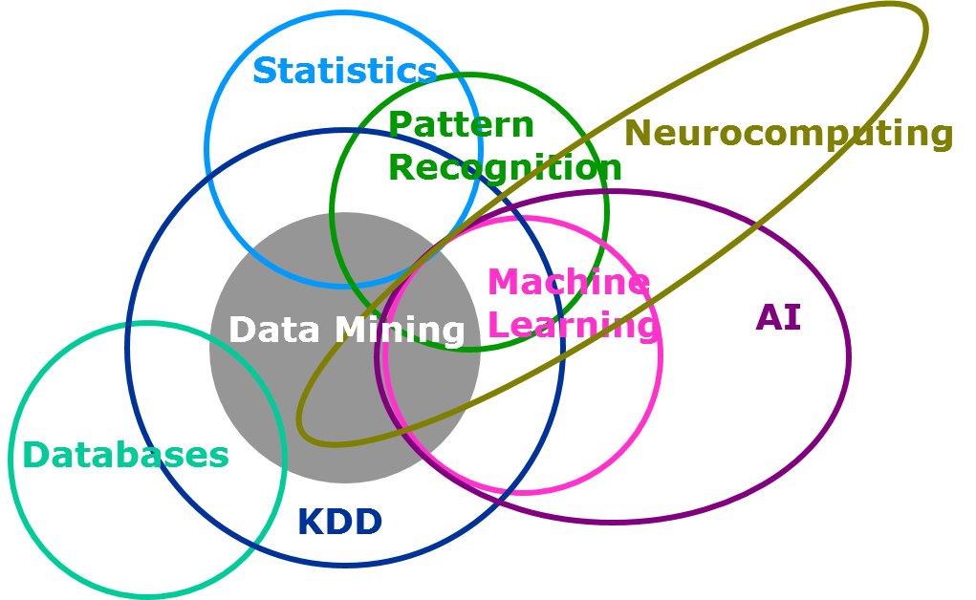
Relations between Data Mining, Machine Learning, AI and others

Slide 18
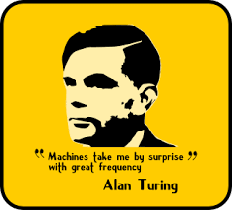
A bit of History of AI

Slide 19
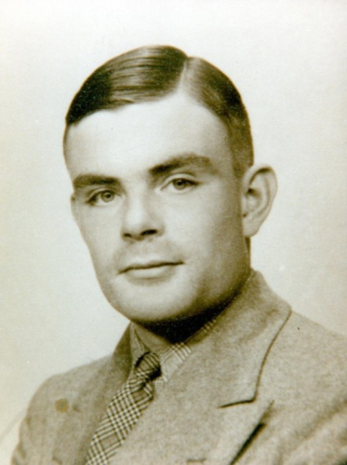
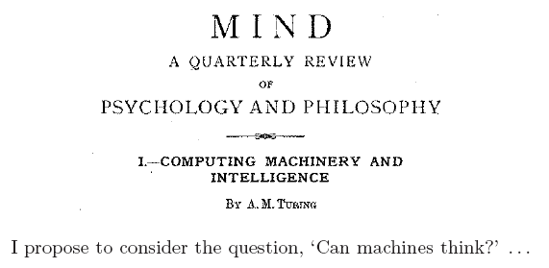
A bit of history of AI (start)
Long long ago…
Philosopher Aristotle (385-322 B.C.)
My story will start from 1950 in the UK and one important publication:
  Turing, A.M. (1950), Computing machinery and intelligence, Mind, Vol. 59, pp. 433-460.

Slide 20
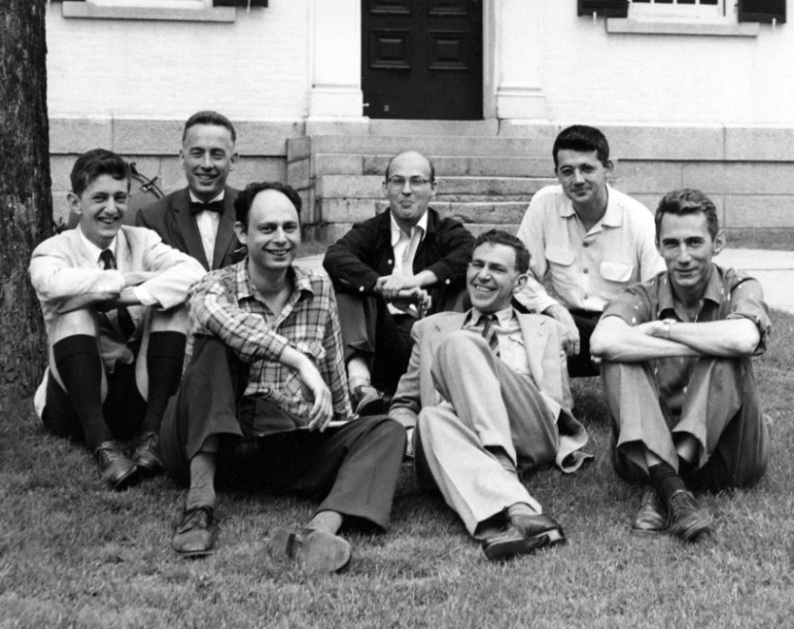
A bit of history of AI (born)
The official birth of artificial intelligence:
  1956: Dartmouth Conference - "Artificial Intelligence" adopted
  The term ‘Artificial Intelligence’ was coined in a proposal for the conference at Dartmouth College in 1956
  1) Dr. Marvin Minsky (MIT co-founder)
  2) Dr. Julian Bigelow (Contri IT)
  3) Professor D.M. Mackay (Neuro)
  4) Mr. Ray Solomonoff (Probability)
  5) Mr. John Holland (genetic)
  6) Mr. John McCarthy (MIT, lisp)
  7) Dr. Claude Shannon (IT)

Slide 21
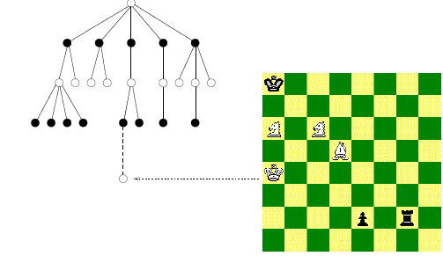
A bit of history of AI (early days)
Two major themes that driven AI development from start to today are: Game-play and Robot
One of the early research in AI is search problem such as for game-playing. Game-playing can be usefully viewed as a search problem in a space defined by a fixed set of rules
Nodes are either white or black corresponding to reflect the adversaries’ turns.
The tree of possible moves can be searched for favourable positions.

Slide 22
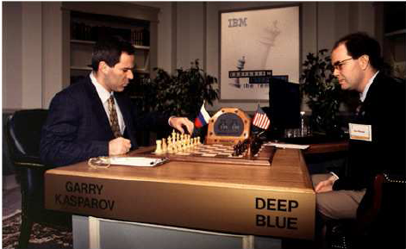
A bit of history of AI (victory)
The real success of AI in game-playing was achieved much later after many years’ effort.
It has been shown that this search based approach works extremely well.
In 1996 IBM Deep Blue beat Gary Kasparov for the first time. In 1997 an upgraded version won an entire match against the same opponent.
https://www.kaggle.com/harryyu/week10-reinforcement-learning-frozenlake-v0

Slide 23
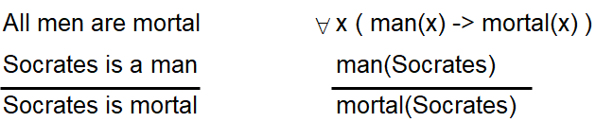
A bit of history of AI (development)
deductive logic (theorem-provers):
Common sense reasoning: the idea was to code common sense knowledge as logical axioms, and employ a theorem-prover (John McCarthy and Patrick Hayes)
  Reasoning as search: Newell and Simon developed a program called the "General Problem Solver".
  Natural language Processing: Ross Quillian proposed the semantic networks and Margaret Masterman & colleagues at Cambridge design semantic networks for machine translation

Slide 24
A bit of history of AI
(golden years)
Golden years: 1956-1974
    Lisp: John McCarthy (MIT) invented the Lisp language.
Funding for AI research:
  Significant funding from both USA and UK governments
The optimism:
  1965, Simon: "machines will be capable, within twenty years, of doing any work a man can do"
  1970, Minsky: "In from three to eight years we will have a machine with the general intelligence of an average human being."

Slide 25
A bit of history of AI
(1ST AI winter)
The first AI winter 1974−1980:
  Problems
    Limited computer power: There was not enough memory or processing speed to accomplish anything truly useful
    Intractability and the combinatorial explosion. In 1972 Richard Karp showed there are many problems that can probably only be solved in exponential time (in the size of the inputs), famously named as NP (nondeterministic polynomial time) complete/hard problem.
    Common sense knowledge and reasoning. Many important applications like vision or natural language require simply enormous amounts of information about the world and handling uncertainty.
  The end of funding
    The agencies which funded AI research became frustrated with the lack of progress and eventually cut off most funding for AI research.
Notes:
There was not enough memory or processing speed to accomplish anything truly useful. For example, Ross Quillian's successful work on natural language was demonstrated with a vocabulary of only twenty words, because that was all that would fit in memory.

Slide 26
A bit of history of AI (Rebranding)
Boom 1980–1987:
  In the 1980s a form of AI program called "expert systems" was adopted (rule-based technologies) by corporations around the world and knowledge representation became the focus of mainstream AI research
    The power of expert systems came from the expert knowledge using rules that are derived from the domain experts
    In 1980, an expert system called XCON was completed for the Digital Equipment Corporation. It was an enormous success: it was saving the company 40 million dollars annually by 1986
    By 1985 the market for AI had reached over a billion dollars
  The money returns: the fifth generation project
  However, the fundamental issue about uncertainty (today we call it probability and fuzzy learning) and capability of dealing with big size data aren’t really solved at all in that time.

Slide 27
A bit of history of AI
(2nd AI winter)
the second AI winter 1987−1993
  In 1987, the Lisp Machine market was collapsed, as desktop computers from Apple and IBM had been steadily gaining speed and power and in 1987 they became more powerful than the more expensive Lisp machines made by Symbolics and others
  Eventually the earliest successful expert systems, such as XCON, proved too expensive to maintain, due to difficult to update and unable to learn.
  In the late 80s and early 90s, funding for AI has been deeply cut due to the limitations of the expert systems and the expectations for Japan's Fifth Generation Project not being met

Slide 28
A bit of history of AI
(late 80s to 90s new ideas)
  In the period of 2nd AI winter (in the late 80s), lots of new ideas are proposed which are the foundations of today’s AI approaches.
  A completely new approach to AI, based on robotics, has been proposed by Brooks in his paper "Elephants Don't Play Chess”, based on the belief that, to show real intelligence, a machine needs to have a body — it needs to perceive, move, survive and deal with the world.
  Artificial Neural Networks (ANN) to learn data features
  Probabilistic and Statistical approach
  Knowledge representation with Fuzzy framework
  Imaging processing and vision recognition
Notes:
This new ideas were also boosted by increased PC powers

Slide 29

Winter again

Slide 30
Brief history of AI
(booming today)
Main reasons:
Hardware power (GPU, storage)
Cloud computing (Internet, IoT)
Big Data (IoT, Mobil App, Social network, Linked data, activities on Internet)
Industry driven (Google, Amazon, Facebook)
the creation of new ties between AI and other fields working on similar problems
A greater emphasis on solving specific sub-problems

Slide 31
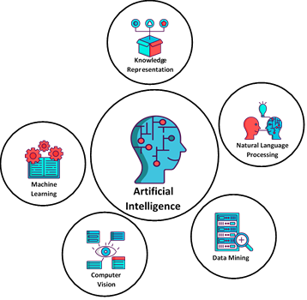
Branches of AI technologies

Slide 32
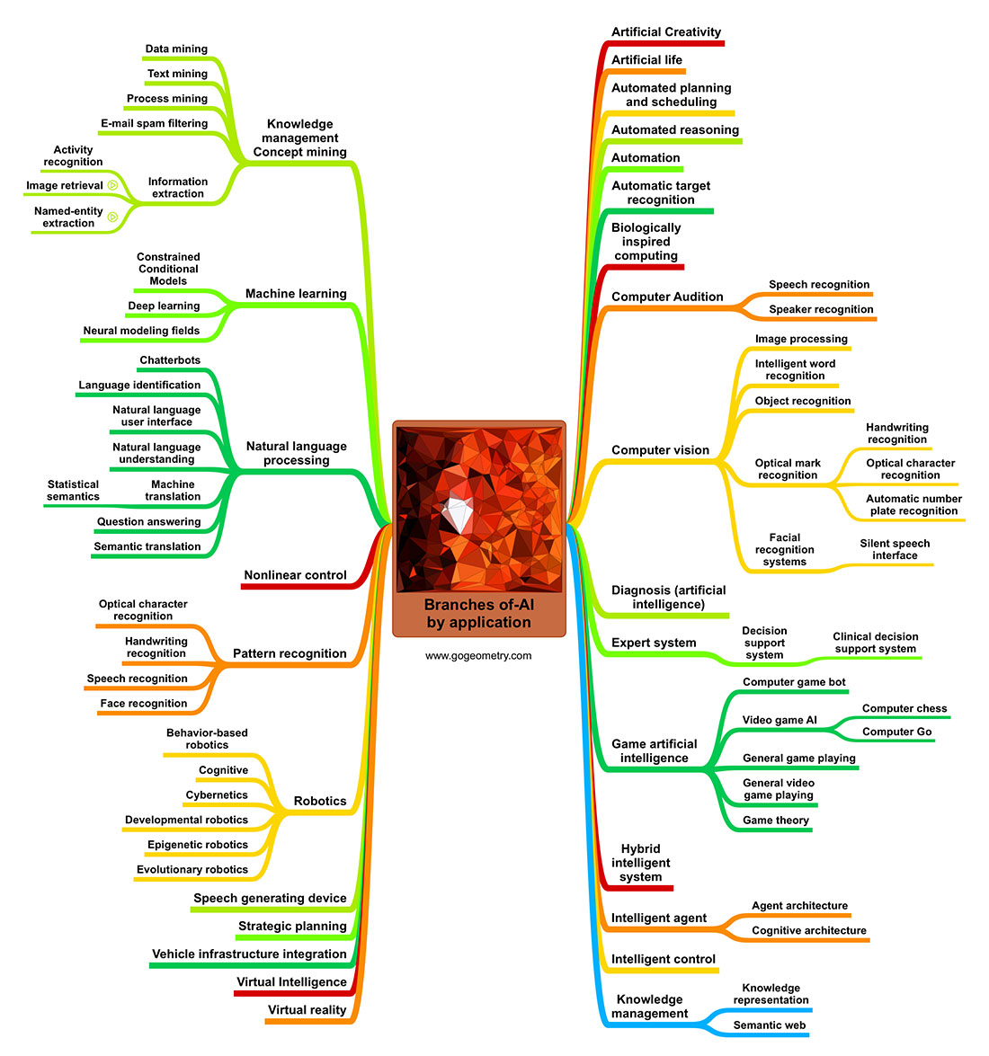
Branches of AI technologies by application

Slide 33
Intelligent level
Logic and inference
Feature learning
e.g. Deep Neural Networks
Reinforcement learning
Probability
e.g. Markov Chain
Bayesian networks
Data reflection
e.g. Decision Tree
Low-level intelligence
High-level intelligence
Explainable
Controllable
Unknown
Self-explainable
demo

Slide 34
Module topics (Teaching Weeks)
Weeks | Theory | Practical
1 | AI history, branches, application scenarios and relations to Data Mining and Machine Learning | Python basics
2 | Data Pre-processing and EDA | Python - Data Pre-processing
3 | Mining Frequent Pattern and Association Rules | Python - EDA
4 | Classification and Decision Tree | Python – ARL
5 | Random FR and KNN | Python - DT
7 | Linear Regression & Logistic Regression | Python – KNN
8 | Cluster Analysis with Unsupervised Learning | Python – LR
9 | Artificial Neural Network & Deep Learning | Python – K-Means
10 | Natural Language Processing (NLP) | Python – ANN and DL
11 | Reinforcement Learning & Naïve Bayes | Python – NLP
12 | Knowledge presentation and reasoning | Python – RL and NB
13 | Review
14 -15 | Assessment period
16-18 | Enrichment period: Offsite Activities (Career support, CV support) and assessment feedback
A1 Deadline
Week 14
A2 Deadline

Slide 35

Turing test

Slide 36
Turing test
In Alan Turing's 1950 paper, Computing Machinery and Intelligence, the mathematician posed the question: "Can machines think?" But almost immediately he dismissed that question as too "meaningless" to be worthy of discussion, and swapped it for the much-more specific: "Are there imaginable digital computers which would do well in the imitation game?"
Turing's "imitation game" was a simple party game with three players -- a man, a woman, and a judge of either sex. The judge sits in a room apart from the man and woman, and has to decide which of the pair is the person, and which is the machine.
https://chatbotsmagazine.com/how-close-are-chatbots-to-pass-turing-test-33f27b18305e
Demo https://openai.com/blog/chatgpt/
Demo https://www.pandorabots.com/mitsuku/

Slide 37
Summary
In this lecture, you takeaway following things:
  Very basic concepts of Data Mining and AI.
  The born of AI and its development history
  Different areas of AI
  The contents and assessment of the module
Next week
Lecture: Data processing and EDA
Practice: Python for deal with missing data and EDA diagrams

Slide 38
Practice, home work and further reading
Complete the first Python practice on Kaggle or Colab.
Try to understand the terms of Strong AI and Weak AI by reading these two articles (You need to answer a question in the discussion board):
http://ceur-ws.org/Vol-2287/paper34.pdf
https://e3zine.com/strong-artificial-intelligence/

